Slide 1


Docker Compose in Production

Slide 2
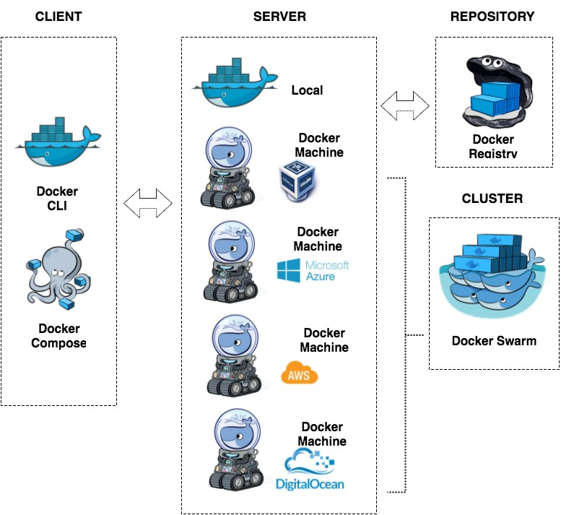
#DockerLima
Docker Ecosystem

Slide 3
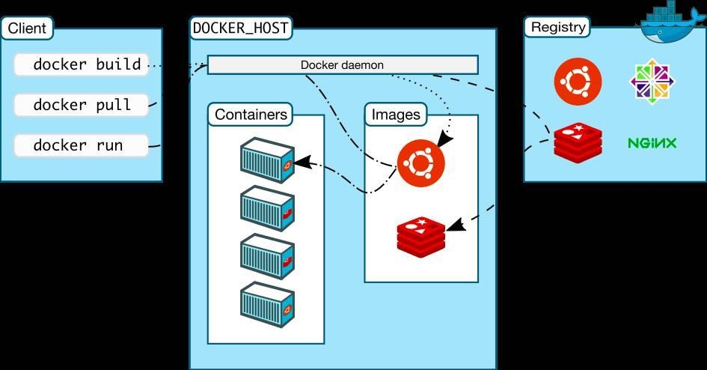
#DockerLima
Docker Flow

Slide 4




Docker Compose
#DockerLima
version: '2'
services: nginx:
image: nginx:alpine-stable volumes:
./html/:/usr/share/nginx/html/
./logs/nginx/:/var/log/nginx/ ports:
- 80:80

Slide 5
Version
#DockerLima
Compose file format
Docker Engine release
3.0; 3.1 1.13.0+
2.1 1.12.0+
2.0 1.10.0+
1.0 1.9.1.+
https://docs.docker.com/compose/compose-file/compose-versioning/

Slide 6
Deploy Composer
#DockerLima
Removing any volume bindings for application code, so that code stays inside the container and can’t be changed from outside
Binding to diﬀerent ports on the host
Setting environment variables diﬀerently (e.g., to decrease the verbosity of logging, or to enable email sending)
Specifying a restart policy (e.g., restart: always) to avoid downtime
Adding extra services (e.g., a log aggregator)

Slide 7
Deploy & Update
#DockerLima
Deploy
$ docker-compose -f docker-compose.yml -f production.yml up -d
Update
$ docker-compose build web
$ docker-compose up --no-deps -d web

Slide 8
Eso es todo, gracias :D
#DockerLima

Slide 9
Docker Mode Swarm
#DockerLima
A partir de Docker Engine 1.12.0
Version compose file 3 para Docker Engine 1.13.0
Provee:
Clustering
Scheduling
Orchestration

Slide 10
Swarm - Key concepts
#DockerLima
Nodes: manager - worker
Services - Tasks
Mode: global - replicated
Load balancing
Placement

Slide 11
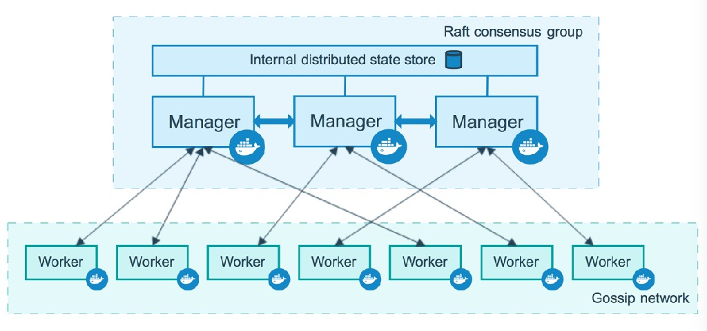
#DockerLima
Manager - Nodes

Slide 12
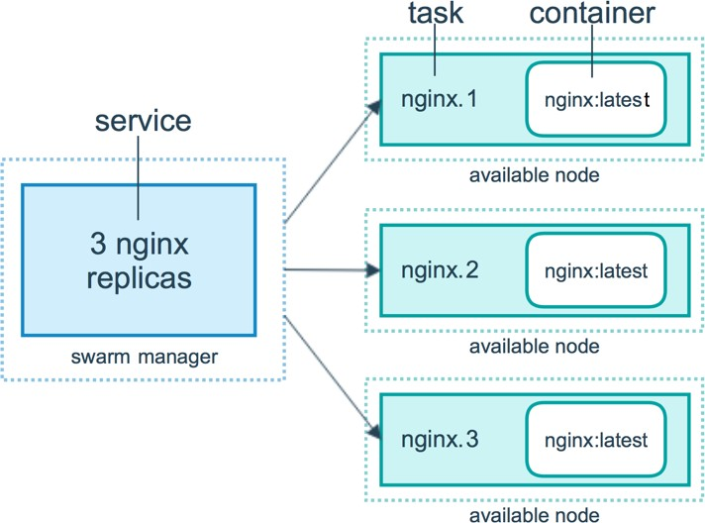
#DockerLima
Service - Tasks

Slide 13
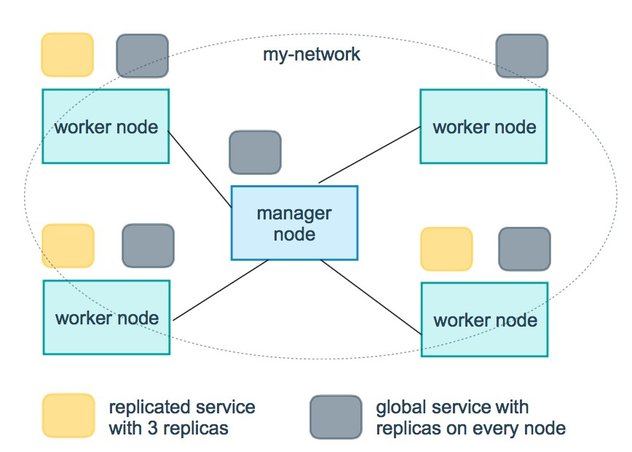
#DockerLima
Global - Replicated

Slide 14
Compose - Swarm
#DockerLima
deploy
mode: replicated
replicas: 4
resources:
limits:
cpus: ‘0.50’
memory: 512M
reservations:
cpus: ‘0.25’
memory: 256M

Slide 15
Compose - Swarm
#DockerLima
deploy
…
restart_policy:
condition: on-failure
update_config:
parallelism: 2
placement:
constraints: [node.role == manager]

Slide 16
Demo
#DockerLima
git clone https://github.com/mario21ic/docker-compose- swarm
docker-compose up -d
docker-compose ps
docker-compose exec web top
docker-compose down --volumes
docker stack deploy --compose-file docker-stack.yml mystack

Slide 17
Swarm - Node
#DockerLima
docker node ls
docker node inspect <node_id>
docker node ps <node_id>
docker node rm <node_id>
docker node demote/promote <node_id>

Slide 18
Swarm - Stack
#DockerLima
docker stack deploy --compose-file stack.yml mystack
docker stack ls
docker stack services <stack_id>
docker stack ps <stack_id>
docker stack rm mystack

Slide 19
Swarm - Service
#DockerLima
docker service ls
docker service ps <service_id>
docker service ps mystack --filter name=
docker services logs <service_id>
docker service scale <service_id>=<number_tasks>
docker service update --image mario21ic/nginx:prodv2 mystack_web
docker service rm <stack_id>

Slide 20
Swarm - Service
#DockerLima
docker service create --name serv_registry --publish 5000:5000 registry:2
docker service ls
docker service ps serv_registry
docker service logs serv_registry
curl http://localhost:5000/v2/

